Slide 1
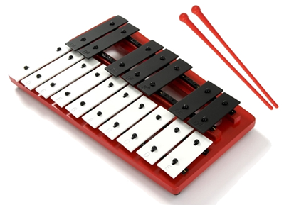
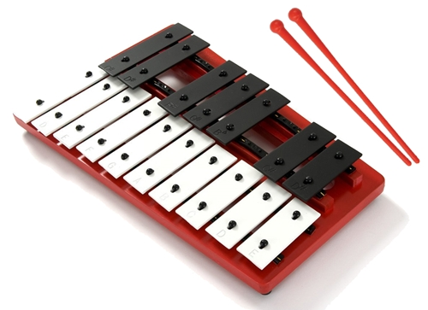
Our Lady of the Wayside
Dinky Glocks Rock
Concert
Year 1 and 2

Slide 2
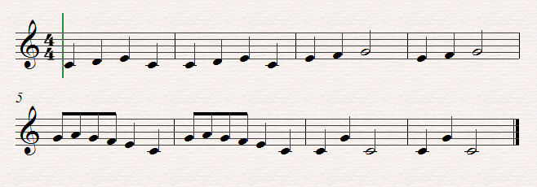
Frere Jacques
Yr 2
Miss stanton
Sing it
Mrs D sing it and you play
Play it
C D E C
C D E C
E F G
E F G
G A G F E C
G A G F E C
C G C
C G C

Slide 3
Sing me, play part 1.
Sing me, play part 2.
Sing me.
D
E
D

Slide 4
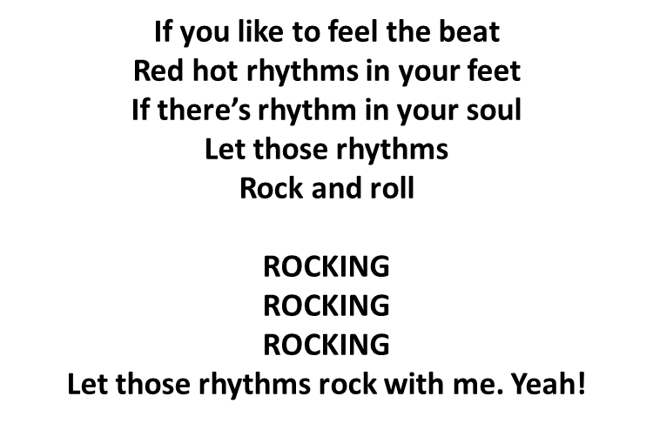
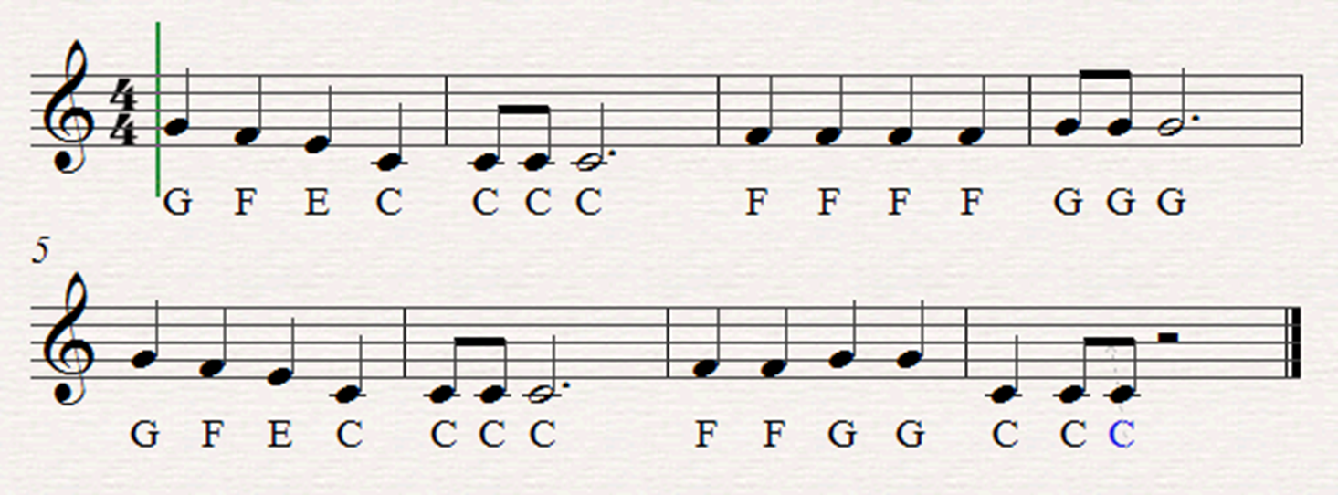
Sing me, play part 1.
Sing me, play part 2.
Sing me.
Yr 2
Miss Jackson
Part 1
Part 2

Slide 5
Havana
x4
1 2
x4
1 2
x4
1 2

Slide 6
Sing it , play it , sing it , play it
Dm
Yr 1
Mrs compton
Is that a Ghost creeping up the stairs
Trying to catch you unaware
Wooo Wooo Boo! It’s just me.
Gm
A
Dm
Gm
Dm
Am
Dm
Woooo
Dm
Gm
Dm
Woooo
Am
boooo

Slide 7
Front row, middle row, back row, everyone
Bossa Nova Its all over!
G G A A B
G G A A B
2,3,4,
2,3,4,
G G A A B
B B A A G
2,3,4,
2,3,4,

Slide 8
The year 1
wiggle
Yr 1
Mrs oakley
CC C
CC C
CC C
ED C

Slide 9
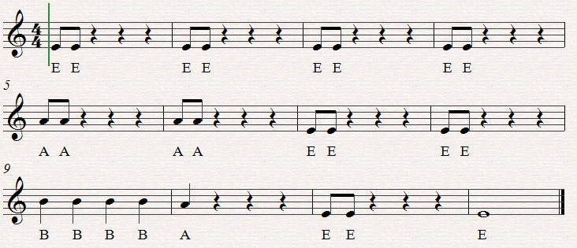
I spied a spy
Play me 2 times

Slide 10
Goodbye Song
Oh, Oh, Oh
It’s time to go
Put away
Call it a day
Oh Oh Oh
We had some fun but
Until next week goodbye

